Slide 1
STANDARD MAPS GENERATION FROM SATELLITE IMAGES USING CONDITIONAL GAN
Anjan Sharma (HCE074BCT005) Supervised by: Er. Madhu Nyoupane
Anudit Adhikari (HCE074BCT006)
Arish Prasain (HCE074BCT008)
Subhashish Basnet (HCE074BCT036)

Slide 2
Overview
Introduction
Objective
Literature Review
Feasibility Study
Requirement Analysis
Block Diagram, System Design and Architecture
Methodology
Work Analysis

Slide 3
Introduction
Creating Maps is very expensive and time consuming
Map dependent Apps like : tootle,pathao
Problems with google maps
Unreliable layers of map for Country like Nepal
Proposal of cGAN
Other scopes(Drone Images)

Slide 4
Objective
To generate a standard maps from satellite images using Conditional GAN

Slide 5
Literature Review
Ian Goodfellow (2014)
Introduced GAN in his paper.
Philip Isola (2016)
Used cGAN for image to image translation
Zhu (2018)
Used cycle GAN to generate maps
Why GAN?
Ability to model high-dimensional data
Capacity to provide multi modal outputs or multiple plausible answers.
High success rate
Better Computational speed and power

Slide 6
Functional Requirement
Acquire Maps
Generate Maps
Non-Functional Requirement
Scalability
Usability
Flexibility

Slide 7
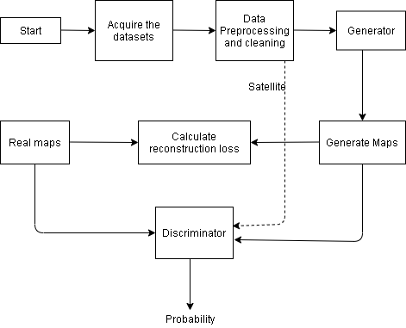
Block Diagram

Slide 8
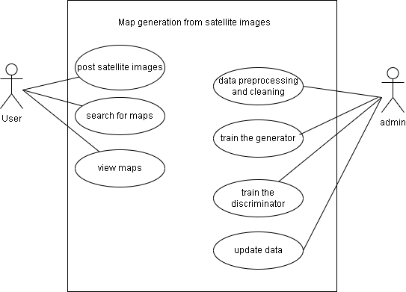
Use Case Diagram

Slide 9
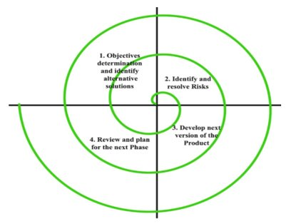
Methodology
Software Development Cycle

Slide 10
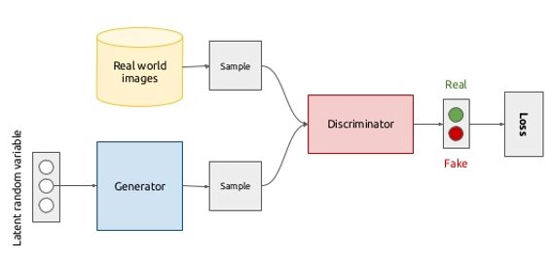
What is GAN?

Slide 11
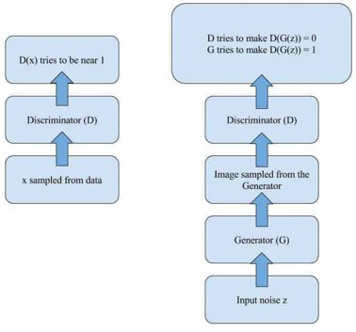
Component Of GAN

Slide 12
Loss Function
Discriminator Loss: max_{(D)} E_{x~P(x)} [log(D(x))]+ E_{z~Pz(z)} [log(1-D(G(z)))]
Generator Loss: min_{(G)} E_{x~P(x)} [log(D(x))]+ E_{z~Pz(z)} log(1-D(G(z)))]
Reconstruction Loss: ||M_{fake}-M_{real}||₂

Slide 13
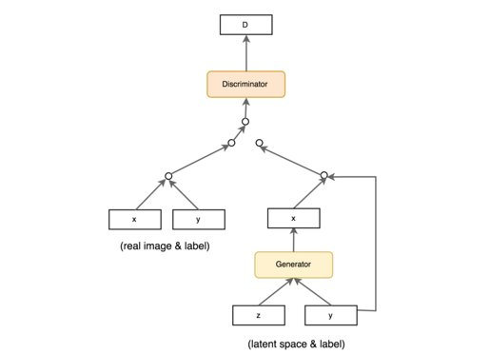
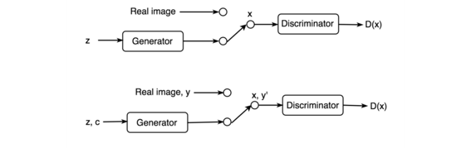
Conditional GAN

Slide 14
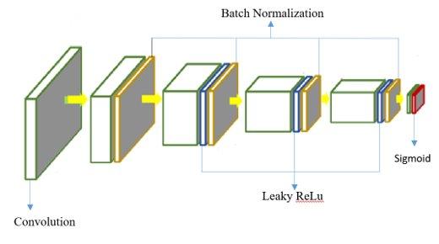
PatchGAN Discriminator
PatchGAN discriminator determines whether an image is real or fake by using local patches of the size.
It takes two input the real image(x) and fake image G(x).
Consists of five downsampling convolutional-BatchNormLeaky layers

Slide 15
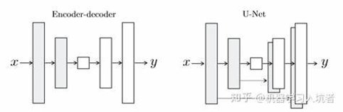
U-Net Generator
The generator takes in the image to be translated and compresses it into a low dimensional, bottleneck, vector representation.
The information from earlier layers are integrated into later layers through skip connections.
Skip connections do not require any resizing, projections, etc. since the spatial resolution layers being connected already match each other.

Slide 16
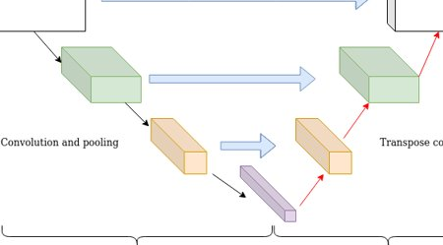
U-net Architecture

Slide 17
Work Analysis
Work completed
Construction of convolutional neural network for generator and deconvolutional neural network for discriminator, which corrects each other.
Available datasets trained
Work Remaining
Optimizing the model for us to obtain the assumed threshold.

Slide 18
THANK YOU

